Slide 1

INVESTMENT ENVIRONMENT IN VIET NAM

Slide 2
REASON TO CHOOSE INVESTMENT ENVIROMENT
IN VIETNAM
Viet Nam is highly appreciated on stable policy and social safeness
Annual GDP growth is steady and is overestimated in the region: about 6.52%/year (2006-2016)
Vietnam Government gives many preferential treatments and investment incentive, specially in garment and textile, leather footwear such as customs (import duties) for raw materials which used for re-exporting products within 3-4 months, exemption and reducing on corporate income tax, etc…
Age structure of Population is youth, the rate of working age population is high; Labor cost is low and their skill and experience is rather high.
Vietnam signed Trade agreements with some regions such as FTA, Vietnam - Korea, AFTA, CAFTA, ...

Slide 3
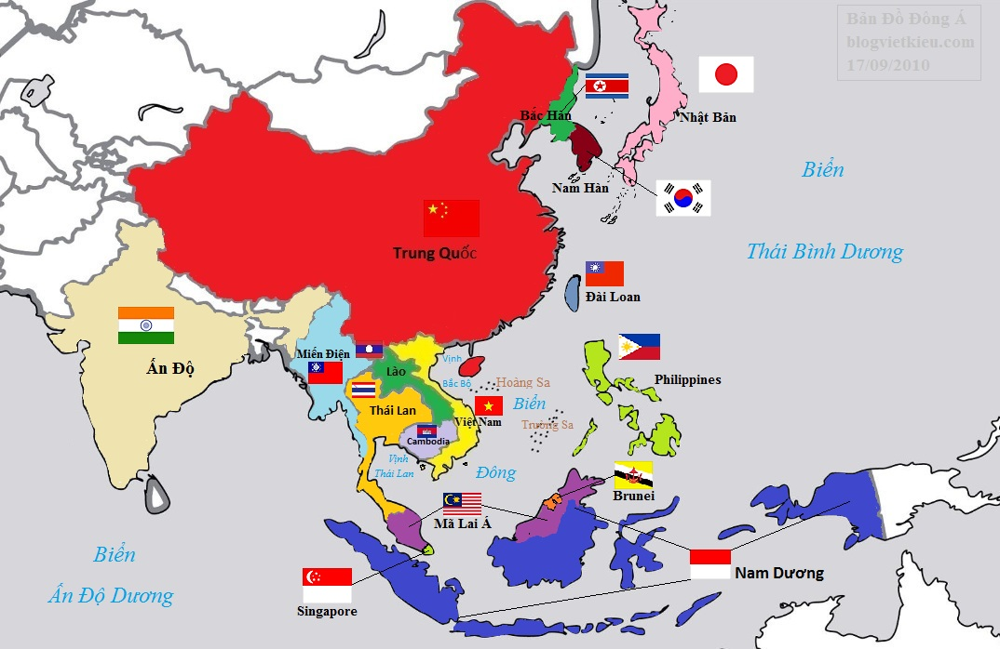
CÁC HIỆP ĐỊNH THƯƠNG MẠI ĐÃ KÝ KẾT
AFTA:-
-signed December 1995
- From 2018 tax will be zero for all commodities.
ACFTA:
- signed November 2004
- Tax will exemption for about 90% of commodities
AIFTA:
- signed August 2009
- From 2016 – 2021 tax will reduce to 0%
AKFTA:
- signed August 2006
- From 2016, tax will reduce to 0 – 5% for 90% of commodities
- From 2017, tax will be exemption.
FTA Viet Nam– Korea:
- signed December 2014
- Tax will reduce to 0 – 5% for 90% of commodities
VNEUFTA
- From June 2012 to present, ongoing negotiation
- Specially, garment is reduce from 11,6% to 0%.

Slide 4
Minimum wage is high competitive to the local region
Working time for 300 days/year (48 hours/week)
 | Basic wage (VND/month)
Region | 1st | 2nd | 3rd | 4th
Wage (VND) | 3,980,000 | 3,530,000 | 3,090,000 | 2,760,000
USD | 176 | 156 | 136 | 122
Social insurance rate: 32% (21.5% paid by employer, 10.5% paid by employee)
Working hours: 8 hours/day/shift (SME may arrange 3 shifts/day)
Work overtime: 4 hours/day (do not exceed than 200 hours/year)

Slide 5
THE INDUSTRIAL PARKS OF PHU THO PROVINCE

Slide 6
GENERAL INTRODUCTION TO DEVELOPMENT AND INVESTMENT CONDITIONS IN PHU THO
1. Geography
Phu Tho is a midland province in the Northern of Vietnam. The province plays as a northwest gate of Hanoi capital with nature land area is at 3.532km2. Phu Tho is placed on economic corridor Hai Phong - Hanoi - Kunming (China), , the East is bordering with Vinh Phuc province and Hanoi city, the West is next to Son La province, he South is next to Hoa Binh province, and the North is next to Tuyen Quang and Yen Bai province. Distances from Phu Tho to Noi Bai International Airport 50 kilometers, and 80 kilometers to Ha Noi city’s center, is 170 kilometers to Hai Phong port, and far from Hakou border gate (Between Lao Cai – Viet Nam and Yunnan – China) at 200km. This province is the center of the region and be confluence by three large rivers (Da river, Red river, and Lo river),.
2. Development planning on industrial parks
Under the document No.: 2501/TTg-KTN dated 10thDecember 2014 by the Prime Minister on adjusting the development planning on Phu Tho industrial parks to 2020;
General planning on industrial parks to 2020 includes 7 industrial parks, with total land area at 2.319ha in details: industrial parks of Thuy Van, Trung Ha, Phu Ha, Cam Khe, Phu Ninh, Tam Nong, Ha Hoa.

Slide 7
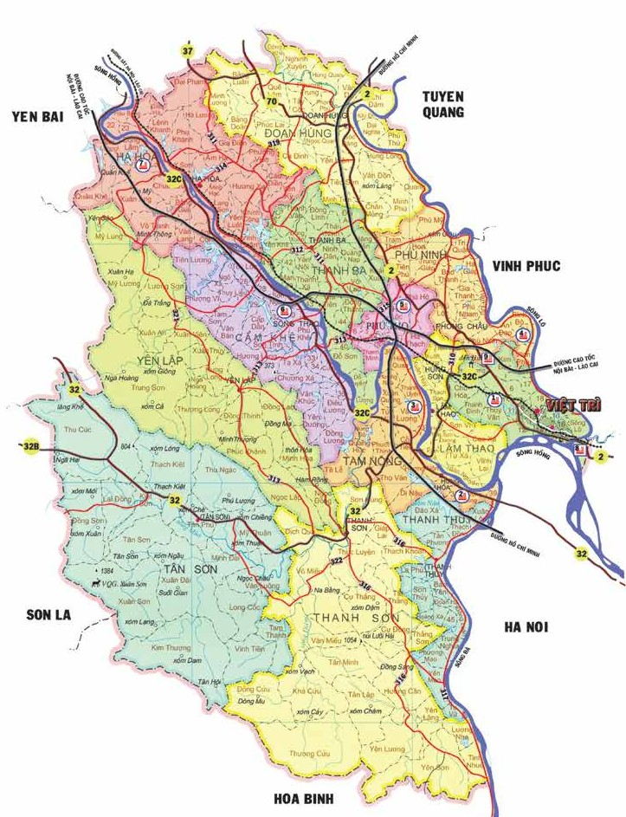
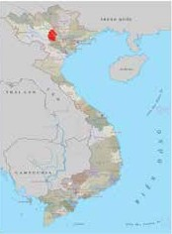

















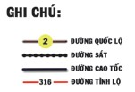
GENERAL PLANNING FOR DEVELOPMENT OF PHU THO PROVINCIAL IPS
IC-11
Ha Hoa Industrial zone
IC-10
IC-9
Phu Ninh Industrial zone
Cam Khe Industrial zone
Phu Ha Industrial zone
IC-8
Song Thao Industrial zone
IC-7
Dong Lang Industrial cluster
Yen lap Industrial cluster
Tam Nong Industrial zone
Thuy Van Industrial zone
Bach Hac Industrial cluster
Trung Ha Industrial zone
Tan Phu Industrial cluster
Thang Son Industrial cluster

Slide 8
GENERAL INTRODUCTION TO DEVELOPMENT AND INVESTMENT CONDITIONS IN PHU THO
3. Transportation infrastructure
Phu Tho located at good geographic place for transportation, among economic corridor Kunming (China) – Lao Cai – Ha Noi – Hai Phong, Quang Ninh. The province contains some important highways as 2, 32, 32B, 32C, 70, Noi Bai – Lao Cai highway, Hochiminh road, Lao Cai – Ha Noi – Hai Phong railway route, and where concentrated center river routs, thus it is best conditions for the province connecting and exchanging with Hanoi, surrounding provinces and whole nation.
The province’s traffic is diversified system, contains on land, in water, and railway and reasonable distributed for cargo and passengers exchange within and out of the province.
On land traffic net includes highways, provincial road, city road, district road, commune road, and village road; with total length of road is at 10.000 kms.
There are 3 large rivers that run through Phu Tho province, including rivers of Hong, Lo, and Da. They are confluence at Viet Tri city. Further more, there are some kind of tributary rivers such as Chay, Bua. All of them are connected as river traffic system. Total length of in water road in Phu Tho is 248 kms, and it ensures the good operation of towboat, barge in rainy season.

Slide 9
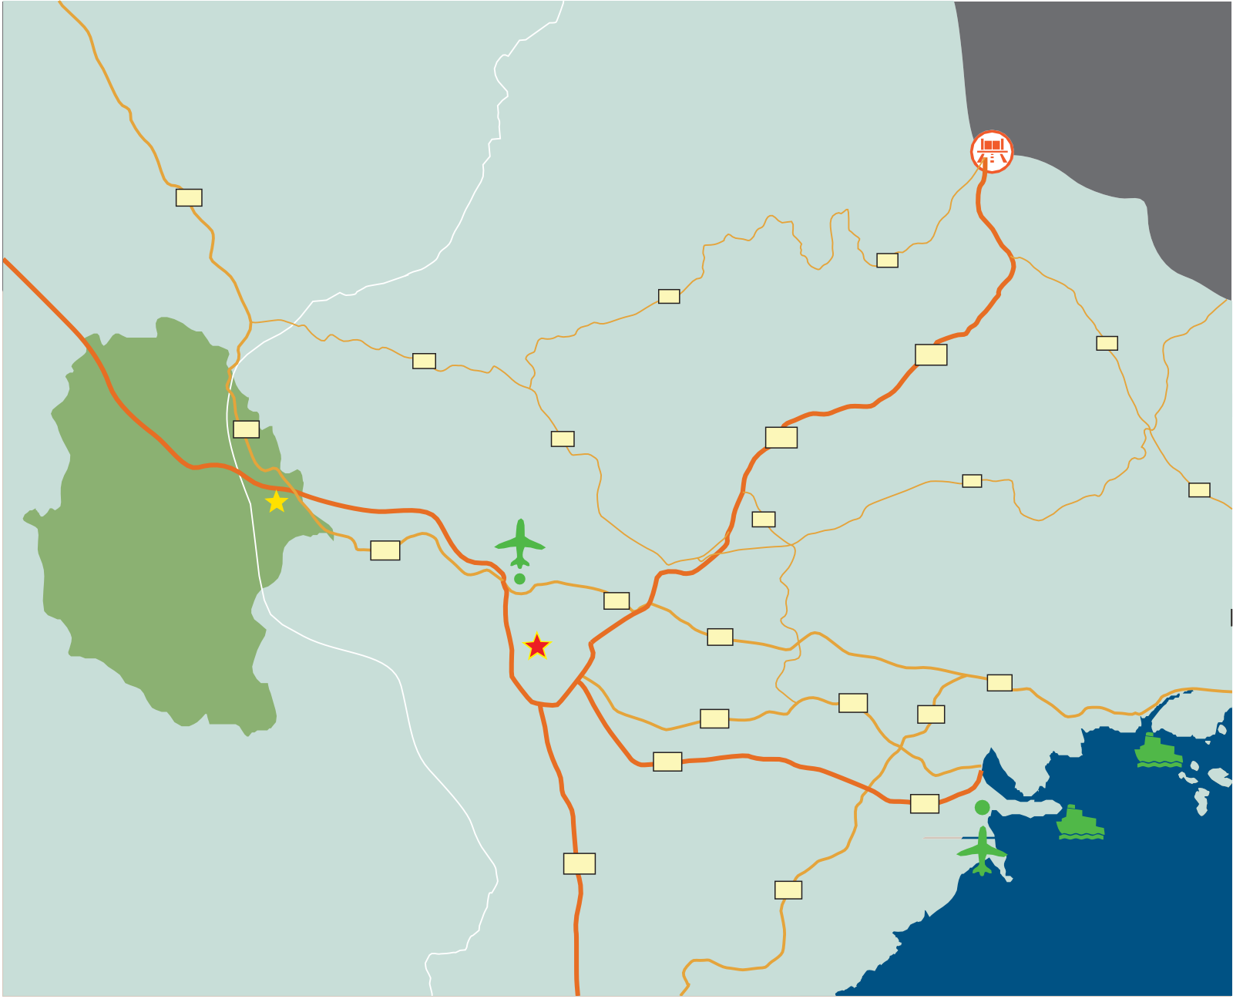


MAP OF TRANSPORT CONNECTION FROM PHU THO PROVINCE
HA GIANG 220 km
CAO BANG 310 km
TAN THANH
BORDERGATE 250km
2
TUYEN QUANG
1B
LAO CAI 200 km
Hochiminh Road
1B
37
THAI NGUYEN
1
4B
NOI BAI - LAO CAI HIGH WAY
LANG SON
2
37
1
VINH PHUC
31
PHU THO
NOI BAI AIRPORT
50 km
4B
VIET TRI
37
2
QUANG NINH
18
HA NOI
80 km
18
SON LA
BAC NINH
18
5A
5A
10
HOA BINH
5B
HAI DUONG
Hochiminh Road
5B
CAT LAM SEAPORT
185 km
HAI PHONG
200 km
1
HAI PHONG SEAPORT
180 km
10
CAT BI AIRPORT
175 km
THAI BINH

Slide 10
GENERAL INTRODUCTION TO DEVELOPMENT AND INVESTMENT CONDITIONS IN PHU THO
4. Technical infrastructure
Electricity: Phu Tho connected and passed with the national electricity power network (including 500kV, 220kV, 110kV) from hydroelectric power plants: Thac Ba, Hoa Binh, Son La. Electricity system of Phu Tho is stable and national electricity network for all demand of living and production, and reaches to gate of all provincial industrial parks.
Communication: now, the province is supplied almost telecommunication service with high quality under one national telecommunication network, it ensures the best and thoroughly connection of whole nation.
Besides good conditions on geographic location and infrastructure of the province, Phu Tho has good potentialities on land, natural resources, labor. There are best and preferential premises for developing industrial sector.

Slide 11
GENERAL INTRODUCTION TO DEVELOPMENT AND INVESTMENT CONDITIONS IN PHU THO
5. The provincial policy
The provincial policy is stable development on industry, especially focusing on key industrial productions of the province. Manages, promote exiting industrial parks effectively; invests to build new industrial parks; improves scope and quality of investment incentive; encourages high technological projects, fresh technology, new and high value products; to improve the provincial economy on quality and competitiveness of product and enterprise.

Slide 12
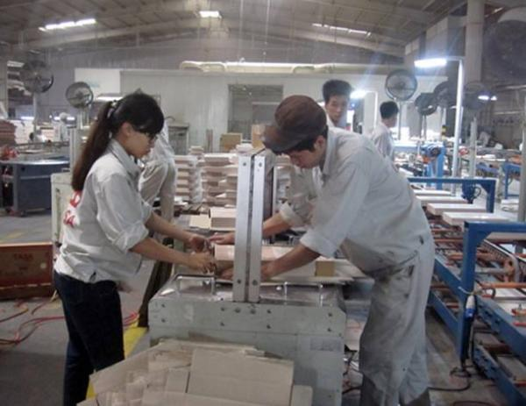
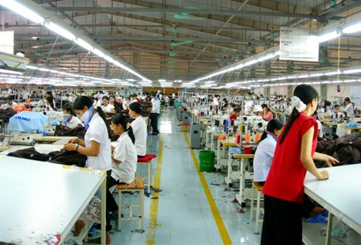
GENERAL INTRODUCTION TO DEVELOPMENT AND INVESTMENT CONDITIONS IN PHU THO
6. Labor force of Phu Tho province and surrounding areas: about 13,454M (working age population is 60%)
Phu Tho 1.370.000
Tuyen Quang
746.700
Ha Noi
7.588.000
Hoa Binh 808.200
Son La 1.149.000
Vinh Phuc 1.021.000
Yen Bai
771.600

Slide 13
WELCOME TO CAM KHE INDUSTRIAL PARK

Slide 14
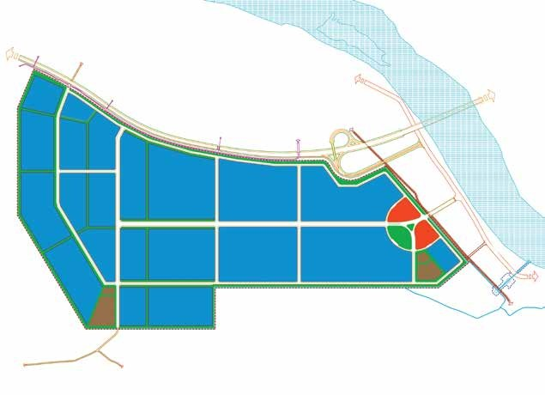

GENERAL LAYOUT OF CAM KHE INDUSTRIAL ZONE
PHU THO PROVINCE
TO LAO CAI (250km)
SON NGA
SAI NGA
TO YEN BAI(30km)
SON NGA
TO HA NOI(100km)
TO NOI BAI (75km)
CONNECTING POINT IC-10
SAI NGA
NOI BAI - LAO CAO HIGH WAY
HONG RIVER
TO IC-10 (1km)
HIGHWAY 32
TO QL32
0,5km
THANH NGA
TO HA NOI(100km)
TO SONG THAO TOWN(2km)
TO SON TINH
TO SONG THAO TOWN
SONG THAO TOWN

Slide 15
INTRODUCTION TO CAM KHE INDUSTRIAL ZONE
1. Location
Cam Khe Industrial zone located on the northwest of Phu Tho province, placed on area of 4 communes: Sai Nga, Thanh Nga, Son Nga, Xuong Thinh, Cam Khe district, Phu Tho province.
2. Total land area: 450ha
3. Characteristics of planning land for the industrial park
- It is 3 kms distance from the industrial park to Cam Khe district’s center, where located 1 district general hospital, other health care centers, branches and transaction offices of banks as Agribank, Vietnam bank for social policies, etc…
- On land traffic: There is a traffic system and connects from the industrial park to Noi Bai – Lao Cai highway at IC.10 crossing point, it is 0.8km from Cam Khe Industrial zone; and is 100 km to Hanoi city; 250 kms to Lao Cai border gate; and 150 kms to Hai Phong port.
- Railway: nears to Phu Tho railway station (Phu Tho township) and Chi Chu railway station (Thanh Ba district).
- In water way: the distance to Hong river’s is short and it is good condition for transportation in water.
  - Airway: the distance to Noi Bai airport is 75 kms.

Slide 16
INTRODUCTION TO CAM KHE INDUSTRIAL ZONE
- Available infrastructure
+ Electricity power network: electricity lines 35kV, 110kV nears to planning place of the Industrial park.
+ Water supply: water supplied at 12.000m3/day for living and industrial demands of the industrial park.
+ Wasted water treatment: planned and will be built with estimated capacity at 10.500m3/day.
+ Communication: in good condition with suppliers such as Viettel, VNPT.
+ Interior traffic of the industrial park: the width of main road is at 44,5m (two ways with 11,25m each part); interior road’s width is at 11,25m.

Slide 17
INVESTMENT’S COSTS AT CAM KHE INDUSTRIAL ZONE
1. Rent for infrastructure: US$27 - US$45 (excluding VAT)
2. Land rent: US$0.106/m2/year; annual payment for rent. If the investor gives land rent at once (paying all for one time), the land rent shall be deduced at 15% of total.
3. Management’s fee: US$0.507/m2/year (excluding VAT); annual payment for rent. If the investor gives land rent at once (paying all for one time), the land rent shall be deduced at 15% of total.
3. Fresh water fee: VND12.000/m3
4. Electricity for manufacture
- Low tension power: normal hours: VND1.452/kwh; low hours: VND918/kwh; rush/peak hours: VND2673/kwh.
- Medium tension power: normal hours: VND1.572/kwh; low hours: VND1.004/kwh; rush/peak hours: VND2.862/kwh.
3. Wasted water treatment’s fee
- From Level B to Level A: Under Phu Tho regulations
- If the wasted water reaches Level A, fee to let out environment: US$0.18/m3 (excluding VAT)

Slide 18
PREFERENTIAL AND INCENTIVE TREATMENTS ON INVESTMENT IN CAM KHE IP
1. Preferential treatments on investment
Corporate income tax rate is at 17%, exemption for 2 year at 100% of corporate income tax, and reducing for 4 next years to 50%.
Project that placed at the List of preferential treatments on investment: the corporate income tax is at 10% for 15 years, exemption for 4 years and reducing for 9 next years to 50%.
Exemption of import duties (customs) on imported cargo that forming project’s fixed assets.
Exemption of land rent for 5 years
II. Incentive treatments on investment
In garment and textile complex, mechanics, agricultural and forest processing, consuming goods production; building materials, auxiliaries industry, mineral processing, electronic processing and assembling,, pharmaceutical, drinking, etc

Slide 19
LABOR FORCE FOR THE INDUSTRIAL PARK
- Population of Cam Khe district is about 128.537, Phu Tho province’s population is about 1.37M, and the working age population rate is at 61%. This is plentiful labor supplication to industrial demands from industrial parks.
- The latest information from Phu Tho provincial industrial parks PMU said that the labor force in working age of Phu Tho province is about 840,000 persons.
- Populations of some surrounding areas at Cam Khe Industrial Zone:
+ Thanh Ba district: 109.806
+ Yen Lap district: 79.548
+ Tam Nong district: 82.370
+ Ha Hoa district: 108.556
Tertiary education system: diversified as universities, colleges, intermediate schools, vocational schools. There are two universities in Phu Tho province (Hung Vuong University, Viet Tri University of Industry) and 5 vocational colleges.

Slide 20
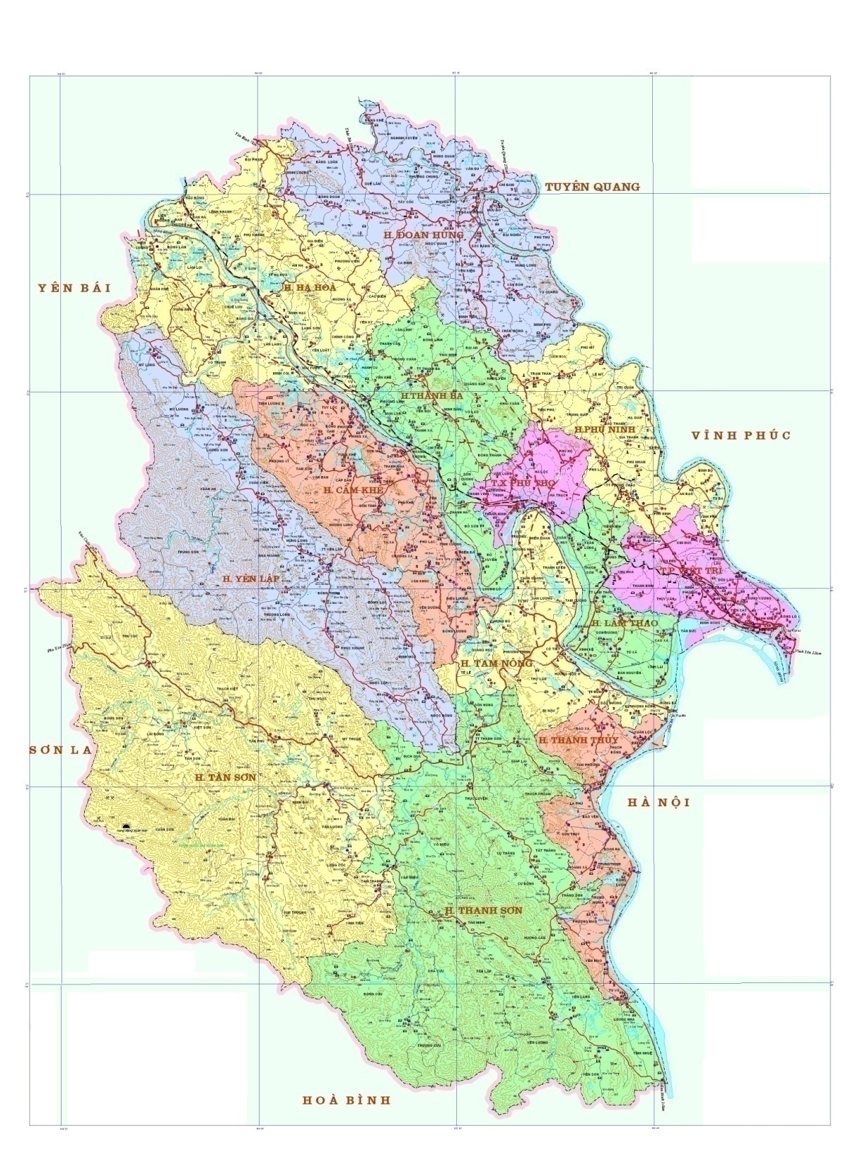
Population surrounding Cam Khe Industrial Zone
TUYEN QUANG
746.700
YEN BAI
771.600
105.242
108.556
30 km
109.806
500,000 Peoples
114.048
128.537
91.600
VINH PHUC
1.021.000
50 km
283.995
79.548
900.000 Peoples
106.610
82.370
SON LA
1.149.000
76.330
75.897
HA NOI
7.588.000
187.700
HOA BINH
808.200

Slide 21
SUPPORTS FROM INVESTOR OF CAM KHE IP
To recommend consulter for general layout plan, draft plan, explanation... All works may be supplied by good reputation and famous consulters.
To support and complete all legal procedure such as working with competent authorities to issue Certificate of Investment, construction permit...
To recommend or directly designing, implementing (construction), supplying and installing machines and equipments, etc. in good conditions and quality, schedule with competitive price from good reputation and famous enterprises.
If the investor hired the industrial zone’s owner for works as construction of plants, the investor shall be received the following preferential treatments:
+ Reduce at 3% of rent for infrastructure
+ Reduce at 10% of re-rent of land (sublease)
+ Exemption for 2 years of management’s fee
To handover the land ground within 3 days since the date that the Land lessee received the Certificate of Investment registration.

Slide 22
CONTACT
Pleases contact us
Head office: Hop Hai Industrial cluster, Kinh Ke commune, Lam Thao district, Phu Tho province
Hotline: (+84) 915 165 999
(+84) 942 686 689
(+84) 975 686 689
Email: khucongnghiepcamkhe@gmail.com
Telephone: (+84) 0210 3793 999
website: khucongnghiepcamkhe.com
khucongnghiepcamkhe.vn

Slide 23


THANK YOU AND WELCOME!

